Slide 1

Introduction to the
Standards for Professional
Learning
Notes:
Materials:
Participant packet and slide #1.
Facilitator:
Display Slide #1 as participants gather.

Slide 2
Learning objectives
Learners will be able to …
Explain the purpose of the Standards for Professional Learning.
Identify the implications of the prerequisite for professional learning.
Understand the purpose and key components of the Standards for Professional Learning.
Identify the alignment between the cycle of continuous improvement and the professional learning standards.
Identify actions to take to improve professional learning within the school or district.
2
Notes:
Materials:
Handout 1.1 and Slide #2.
Facilitator:
Introduce yourself.
Review objectives for the session.

Slide 3
Agenda
3
Notes:
Materials:
Handout 1.2 and Slide #3.
Facilitator:
Review the agenda and purpose for each topic.

Slide 4
Agreements
Be open to defining professional learning in new ways.
Participate actively.
Take responsibility for your own learning.
Honor your colleagues’ learning needs.
4
Notes:
Materials:
Handout 1.3 and Slide #4.
Facilitator:
Review these agreements for the session.
Ask for participants’ cooperation in following these agreements during the session in order to facilitate their own and colleagues’ learning.
Note:
Professional learning includes developing new knowledge and skills and providing ongoing support for classroom implementation. While developing knowledge and skills is a relatively common outcome for professional learning, providing ongoing support for implementation is less common.

Slide 5
vs.
Professional
learning
Professional development
5
Notes:
Materials:
Slide #5.
Facilitator:
Explain the difference between professional learning and professional development. Use the Overview, p. vi, as a reference.

Slide 6

All professional learning is not created equal.
6
Notes:
Materials:
Slide #6.
Suggested comments:
Why do we need standards for professional learning?
Many activities labeled “professional learning” develop knowledge but do not help educators develop new instructional or curriculum skills. Underlying these activities is the assumption that learning will be implemented without support from colleagues, coaches, or outside experts.
Consider the statement on this slide. With a partner, identify evidence you have from your experience that supports or refutes the statement.

Slide 7
Why do we need standards for professional learning?
Silently read Handout 2.1.
As a table team, chart the similarities and differences between the two scenarios.
At your table, predict which professional learning scenario will result in a higher level of implementation. Explain why.
7
Notes:
Materials:
Handout 2.1 and Slide #7.
Facilitator:
Introduce the learning task to compare and contrast two versions of professional learning.
Have teams report sample predictions and explanations.

Slide 8
Relationship between professional learning and student results
In teams of four, review Handout 2.2.
2. Discuss how might you explain these ideas to others.
3. Use a metaphor describe the relationship.
8
Notes:
Materials:
Handout 2.2 and Slide #8.
Facilitator:
Handout 2.2 summarizes the relationship between professional learning and student results.
Suggested comments:
Professional learning that improves student results needs to be high-quality, as described in the standards, in order to have any effect on teacher or student learning.
Quality, effective professional learning is not accomplished through a one-shot workshops but through collaborative, job-embedded, and ongoing development that builds educators’ knowledge, develops skills, and supports implementation.
We will focus on the relationship between professional learning and student results in a brief conversation. Find a metaphor you could use to explain this concept to others.
Facilitator:
Invite table teams to share their metaphors.

Slide 9
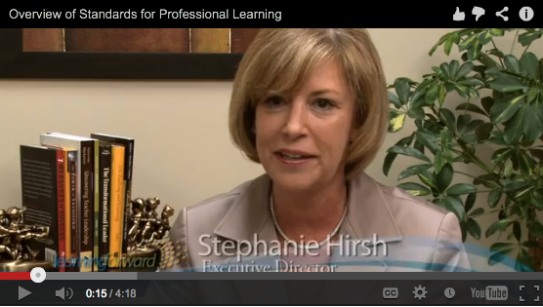
Introduction to the standards
Watch the video.
Use Handout 2.3 as you watch.
At your table, discuss your responses to the questions on the viewing guide.
http://learningforward.org/video-test#.USfvYoU25mN
9
Notes:
Materials:
Handout 2.3 and Slide #9.
Facilitator:
Preview the video to determine whether you think participants should pay special attention to any particular sections during the viewing.
The video is available at http://learningforward.org/video-test#.USfvYoU25mN
Ask table teams to discuss their responses to the questions on the viewing guide.
Sample responses, if desired.

Slide 10
Standards card sort
Use the task directions and materials at your table to complete the card sort.
Make observations about the results of your card sort.
Check your work and discuss variations.
10
Notes:
Materials:
Handout 3.1, copies of the card sort elements from pp. xi-xii of the packet with strips cut apart, a copy of the Standards summary from p. xiii for each participant, and Slide #10.
Facilitator:
Prepare the materials for the card sort activity.
Each small team of two to three should have Handout 3.1 in their participant packet and the 21 components strips provided by the facilitator.
Prepare separately to provide to each participant a copy of the Standards Summary so participants can check their work.
Explain the directions for the card sort activity. Emphasize that each standard has three components and that the components are numbered 1-3 to facilitate sorting them by standard.

Slide 11
Standard for
Professional Learning
Read the standard your table group has been given.
Highlight key elements of the rationale.
Create a windowpane chart using Handout 4.2 as a guide.
Designate a spokesperson to give a 3-minute presentation on the standard to the whole group.
Use Handout 4.3 to take notes on others’ presentations.
11
Notes:
Materials:
Handout 4.1, Handout 4.2, Handout 4.3, Slide #11.
Facilitator:
Handout 4.2 is Standards windowpane template.
Organize a jigsaw process so that there are seven experts or seven expert teams who will study one standard and complete a windowpane on the standard to share with others. Experts might create their windowpane on chart paper.
Facilitate presentations on each standard.
Have participants make notes during the presentations on Handout 4.3: Standards showcase notes so they develop understanding of all the standards.

Slide 12
Reflection
Use Handout 4.4 to reflect on what you learned about the standards for professional learning.
Find a partner and exchange responses from one box.
Rotate to a new partner and exchange responses to a different box.
Meet with two additional partners to share responses from each of the remaining boxes.
12
Notes:
Materials:
Handout 4.4 and Slide #12.
Facilitator:
Ask team members to spend a few minutes reflecting on what they learned about the standards.
Engage participants in a rotating partners process to share responses from their four boxes.

Slide 13
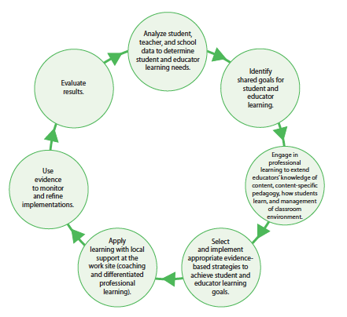
Cycle of continuous improvement
13
Notes:
Materials:
Handout 5.1 and Slide #13.
Facilitator:
Review the elements of the cycle with participants. Stress that each step of the cycle informs the subsequent cycle.
Suggested comments:
Take a moment to identify which steps are familiar to you and routinely are included in your professional learning. Now identify which are most often missing. What are the implications of leaving out some of the steps? Share your responses with your team.
Now let’s identify which standard is reflected in each step. For example, “Analyze student, teacher, and school data to determine student and educator learning needs” is the data standard.
You may want to use your Standards summary, as well as Handout 4.3: Standards showcase notes, as a reference.

Slide 14
Self-assessment and next steps
Complete Handout 6.1 on your own.
Work with a partner to generate possible next steps to improve professional learning so that
it increases educator effectiveness and student learning.
Record your next steps in Handout 6.2.
14
Notes:
Materials:
Handout 6.1, Handout 6.2, and Slide #14.
Facilitator:
After participants have completed the self-assessment in Handout 6.1, have them complete p.1 of Handout 6.2 to summarize the results of their self-assessment before working with a partner to identify their own next steps.

Slide 15
Final reflection
Use Handout 7.1 to stop and reflect.
At your table, share one thing you wrote.
15
Notes:
Materials:
Handout 7.1 and Slide #15.
Facilitator:
Thank participants for their attention and involvement.

